Slide 1
Coffee Shops in Toronto

Slide 2
Who is interested?
Entrepreneurs – the main type of person who would be interested in this project is an entrepreneur looking to open a coffee shop in Toronto.
Without this project an entrepreneur would not have the guidance to make an informed decision on where is best to open their coffee shop.

Slide 3
Data
Toronto Neighbourhood Data, features information regarding the postal codes of Toronto- https://en.wikipedia.org/wiki/List_of_postal_codes_of_Canada:_M
Location Data, possesses data regarding the coordinates of the neighbourhoods of Toronto - https://cocl.us/Geospatial_data
Foursquare API, contains information related to the venues in Toronto - https://foursquare.com/developers/apps

Slide 4
Methodology
After cleaning and compiling the data into a format in which it could be analysed K-Means clustering was used on the neighbourhoods based on the frequency of coffee shops in Toronto. In order to execute this a K-Means clustering algorithm was used.
When using K-Means it is important to not overfit or underfit the model, to achieve this we would need an optimal K. To find this optimal we used the elbow method as can be seen in the code. The optimal value of K from the dataset was 4, thus the dataset will be clustered into 4 clusters. One can see the graph for which the number of clusters was decided on in the next slide.

Slide 5
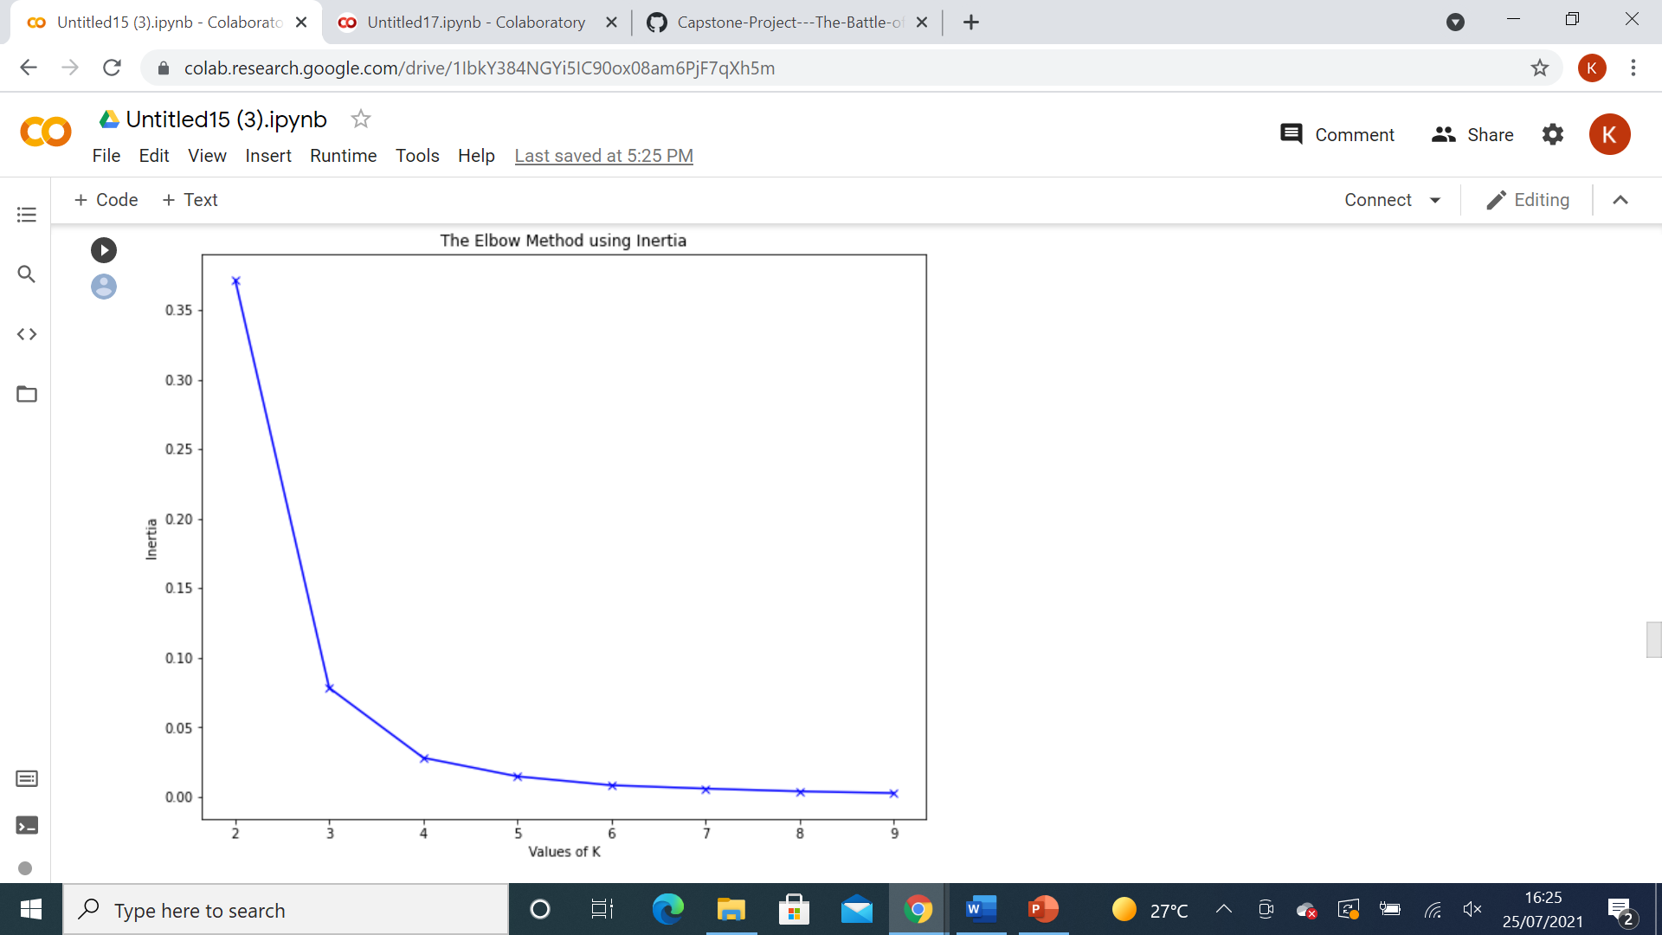
Elbow Method

Slide 6
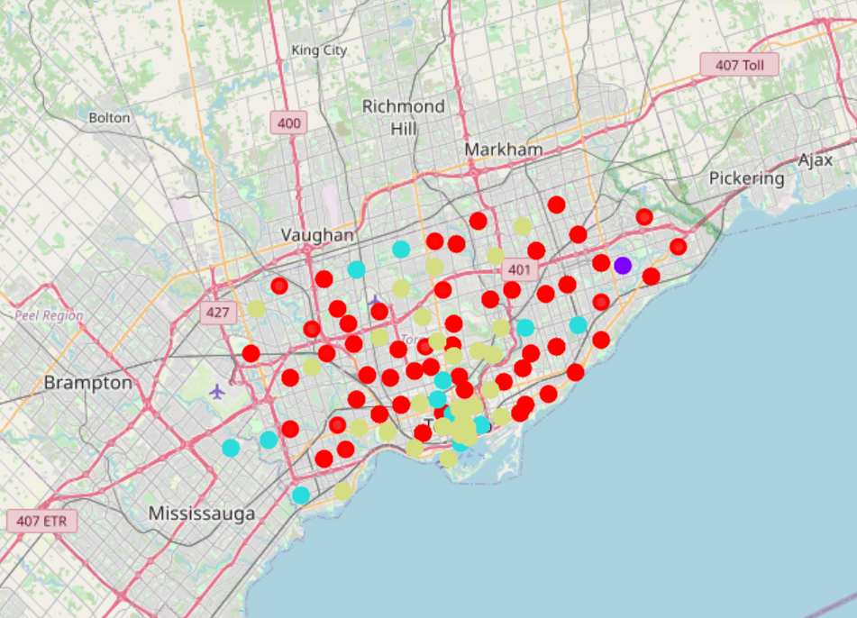
Map of Clusters
After applying the K-Means cluster algorithm to the Toronto dataset such that assigns the neighbourhoods to a specific cluster based on distance.

Slide 7
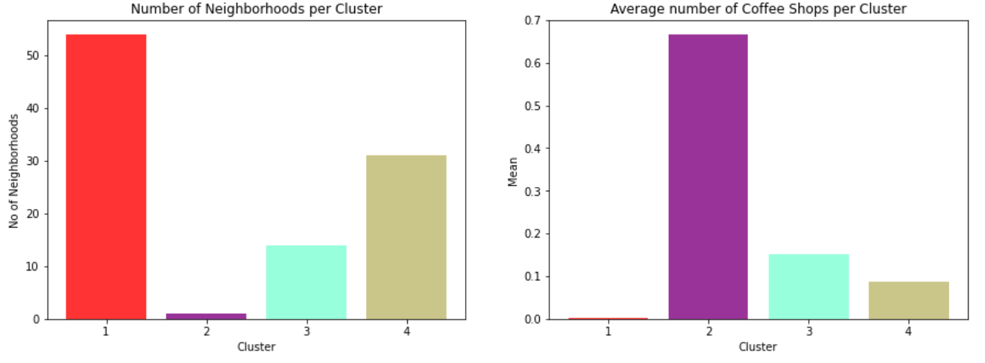
Results and Analysis
The two graphs below both provide meaningful complimentary insights.
The first graph illustrates the number of neighbourhoods per cluster in Toronto, indicating that Toronto has the most neighbourhoods per cluster for this dataset.
The second graph shows the density of coffee shops per cluster by showing the average number of coffee shops per cluster. Showing that the red clusters also have the lowest densities of coffee shops per cluster.

Slide 8
Conclusion
Given the analysis displayed on the previous page, an entrepreneur looking to open a coffee shop in the city of Toronto should look to the red clusters. Due to the fact that they are less populated with coffee shops in those areas, making it less competitive in those areas and giving a business a better chance to succeed.
The code given in this report could also be adapted to fit other cities in addition to other types of venues alongside the Foursquare API.

